Slide 1
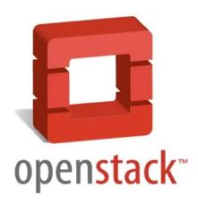
Experimenting Security of OpenStack ‘Keystone’
Presented By
Yun Zhang, Tahmina Ahmed &
Prosunjit Biswas
UTSA

Slide 2
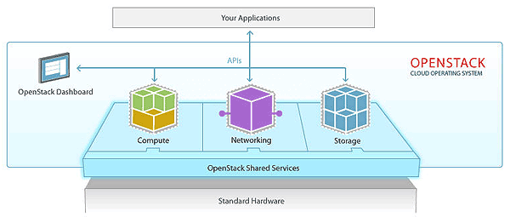
OpenStack
OpenStack is a cloud Software to Manage virtual infrastructures (v. cpu, v. memory and so on) of ‘Infrastructure as a service’ Cloud.
Analogous to a operating system for cloud.

Slide 3
Keystone
Keystone is an OpenStack project that provides Identity, Token, Catalog and Policy services for use specifically by projects in the OpenStack family
Keystone

Slide 4
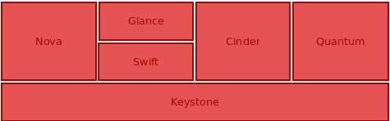
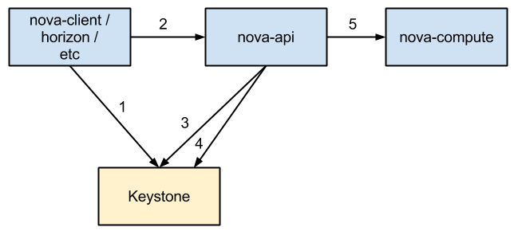
Keystone in the Big Picture
Keystone’s Role in Launching VM instance :
1. Client obtains token from the Keystone
2. Client sends request to Nova API to launch VM instance
3. Nova API verifies token in Keystone
4. Nova requests Keystone to get all available quotas for project/user. Nova calculates amount of used resources and allows or permits operation
5. Nova API calls nova-compute via RPC to launch VM instance.

Slide 5
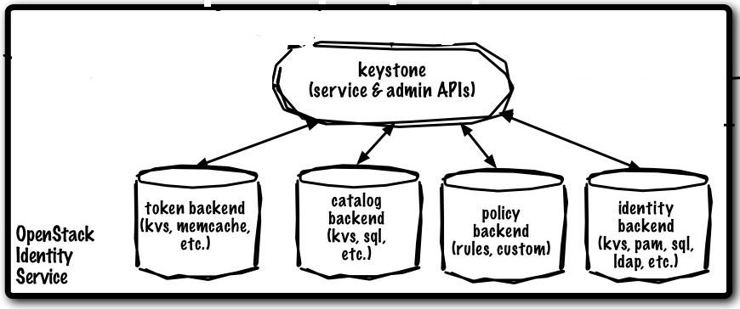
Keystone Components and Operations
Token Operations:
Token Generation
Token Verification
Token Revocation
Signing Token
Service Catalog Ops:
Maintain service list and service endpoint
Identity Mngt Ops
Maintaining Tenant
Maintaining User
Maintaining Role

Slide 6
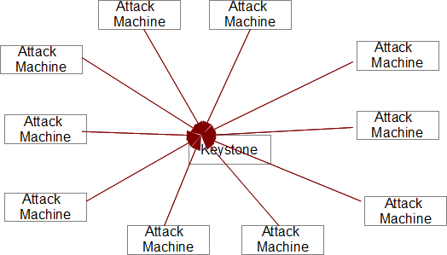
Experiment1 Resilience of Keystone on DDOS Attack
Attack on Keystone with following ops run as a anonymous User:
Generate a token
2. Request for service catalog
3. Ask for token revocation List

Slide 7
Experiment1 Resilience of Keystone on DDOS Attack
Attack Configuration
Keystone is running a VM with following Conf:
V.Cpu:
V. Memeory:
Attack Machine conf:
No. of Machine : 10
V. CPU
V. Memory:

Slide 8
Experiment1 Resilience of Keystone on DDOS Attack
Monitoring Keystone Machine for Attack Resiliency:
Finding Processing time for each request
Finding memory and CPU use of the Keystone machine over time.
Work Plan:
Develop a script that continuously monitor Keystone Machine’s Health status ( CPU utilization, memory Usage)

Slide 9
Experiment2 Checking Randomness of Generated Token
Why token randomness :
It ensures that an attacker generated token never corresponds to a valid token

Slide 10
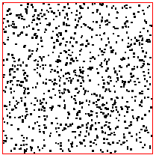
Experiment2 Checking Randomness of Generated Token
Experiment Synopsis :
Generate 10000 token and plot it with scatterplot.
Determine in which probability two generated token are same.

Slide 11

Question / Comment

